Slide 1
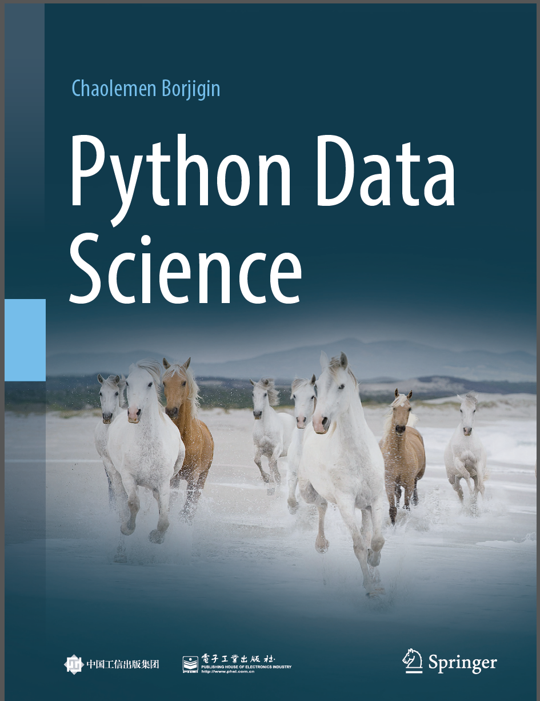
Python Data Science
Chaolemen Borjigin
Renmin University of China
chaolemen@ruc.edu.cn

Slide 2
2.9 While statements
▼ Chapter 2 Basic Python Programming for Data Science
► 2.9 While statements
Chaolemen Borjigin
Renmin University of China
chaolemen@ruc.edu.cn

Slide 3
Summary of this chapter
▼ Chapter 2 Basic Python Programming for Data Science
► 2.9 While statements
2.9.1 Basic syntax
2.9.2 Advanced syntax

Slide 4
2.9.1 Basic syntax
▼ Chapter 2 Basic Python Programming for Data Science
►2.9 While statements
In[1]:
i=1
sum=0
while(i<=100):
sum=sum+i
i+=1
print(sum)
5050

Slide 5
2.9.2 Advanced syntax
▼ Chapter 2 Basic Python Programming for Data Science
►2.9 While statements
In[2]:
i=1
sum=0
while(i<=10):
sum=sum+i
i+=1
if i==6:
continue
if i==9:
break
print(i,sum)
else:
print("here is esle")

Slide 6
2.9.2 Advanced syntax
▼ Chapter 2 Basic Python Programming for Data Science
►2.9 While statements
2 1
3 3
4 6
5 10
7 21
8 28

Slide 7
2.9.2 Advanced syntax
▼ Chapter 2 Basic Python Programming for Data Science
►2.9 While statements
In[3]:
i=1
sum=0
while(i<=10):
sum=sum+i
i+=1
print(i,sum)
else:
print("here is esle")
int

Slide 8
2.9.2 Advanced syntax
▼ Chapter 2 Basic Python Programming for Data Science
►2.9 While statements
2 1
3 3
4 6
5 10
6 15
7 21
8 28
9 36
10 45
11 55
here is esle

Slide 9


